Slide 1
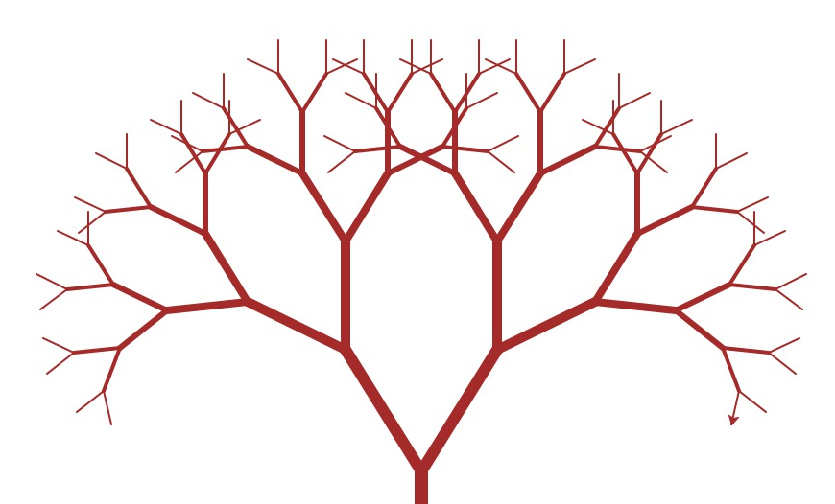
Ideas are Organic
Notes:
In EWH and any job you’ll take. You’ll quickly see how ideas, answers, solutions all begin organically
You get to the best answer through trial and error rather then a stepwise process, let me show you what I mean

Slide 2
“I like… I wish… What if…”
– Stanford D.sign School
Notes:
Now go from the individual and back to the team
Here is the framework to make every project you do better
As you share your ideas among your group, use this format to provide feedback
The goal is to end up with one single idea that encapsulates the best concepts from each project
Here is an example…demo with a student
[10 minutes to present/discuss in group]

Slide 3
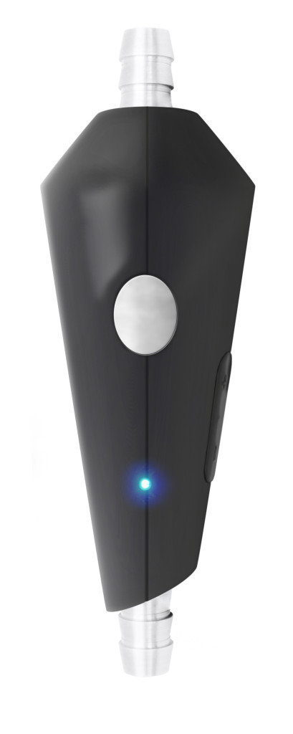


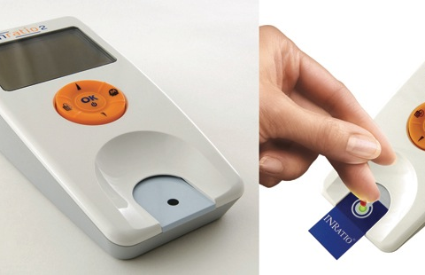
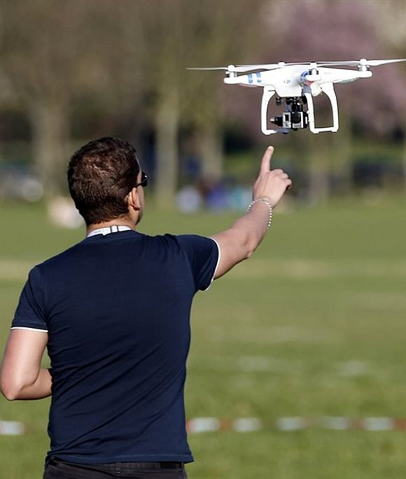
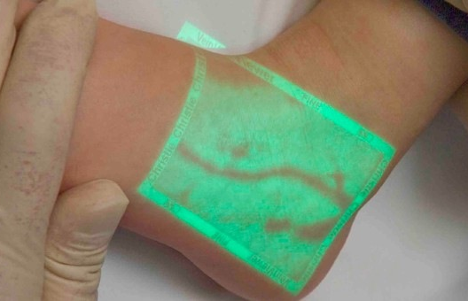
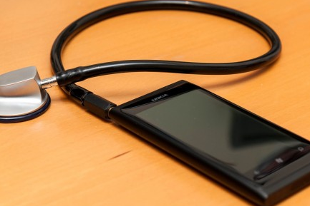
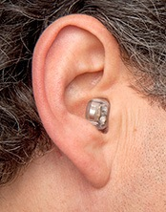

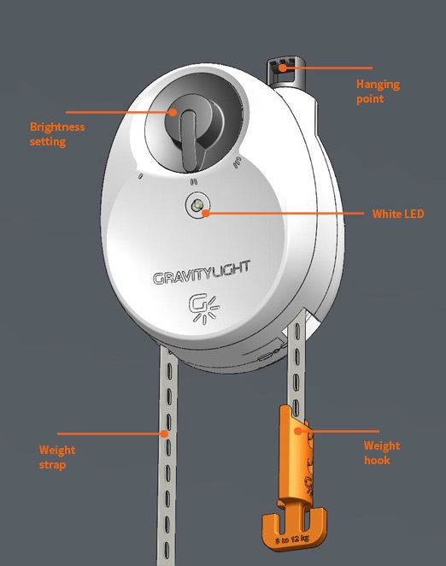
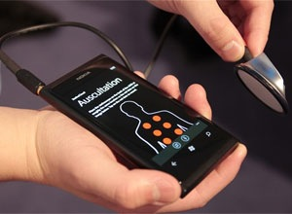
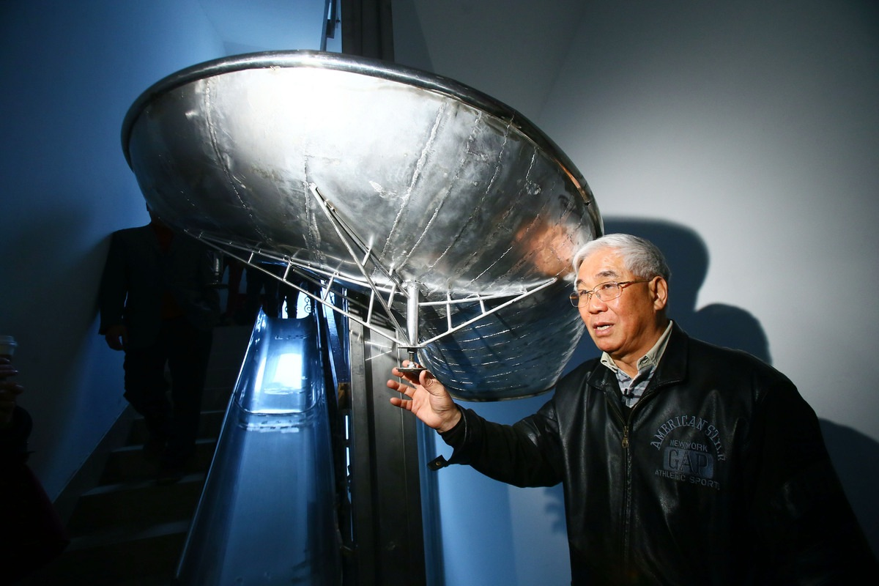
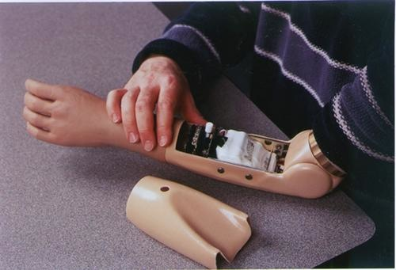

Get to the Best Idea
Notes:
From the ton of ideas generated, I want each individual to pick one idea
They’ll get a chance to sketch it out, think through the idea and create a much more polished concept
I will also add context….Imagine an empty space, we are going to build a hospital around your idea. What would it look like? Your idea is the most-central piece of equipment, what would it do?
[10-15 minutes of brainstorming]
Eko Devices - Smart stethoscope
Gravity Light ($400,00 from a $50,000 goal on IG)
High Rise Evacuation Slide By Zhou Miaorong Installed In Chinese Building (14 seconds)

Slide 4
What did you think was cool?
Notes:
- Quick discussion of takeaways and how people will apply the framework in their own lives

Slide 5
More Resources:
More on ideation and brainstorming:
http://www.ideo.com/work/human-centered-design-toolkit/
http://innovation.umd.edu
Tools for mapping ideas and quality:
http://asq.org/learn-about-quality/seven-basic-quality-tools/overview/overview.html
Keep up to date:
http://medcitynews.com
Notes:
- Quick discussion of takeaways and how people will apply the framework in their own lives

